Slide 1

#RahoAmbitious
TechM Full Stack Software Development

Slide 2



Lecture On: HTML Elements
Instructor: Rushabh Shah

Slide 3
In the previous class, we covered...
What is front-end web development?
How to create websites and web applications?
What are the three ingredients of a website?
Introduction to the world of HTML

Slide 4



Poll 1 (15 Sec)
Fill in the blanks.
<span> is a/an ____ element and <div> is a/an ____ element.
block, inline
inline, block
block, block
inline, inline
Practice in teams of 4 students
Industry expert mentoring to learn better
Get personalised feedback for improvements
4

Slide 5
Poll 1 (Answer)
Fill in the blanks.
<span> is a/an ____ element and <div> is a/an ____ element.
block, inline
inline, block
block, block
inline, inline
Practice in teams of 4 students
Industry expert mentoring to learn better
Get personalised feedback for improvements
5

Slide 6
Poll 2 (15 Sec)
Which of the following tags is/are empty tags?
(Note: Multiple option nay be correct)
<img>
<b>
<p>
<br>
Practice in teams of 4 students
Industry expert mentoring to learn better
Get personalised feedback for improvements
8

Slide 7
Poll 2(Answer)
Which of the following tags is/are empty tags?
(Note: Multiple option may be correct)
<img>
<b>
<p>
<br>
Practice in teams of 4 students
Industry expert mentoring to learn better
Get personalised feedback for improvements
9

Slide 8
Poll 3(15 Sec)
Which of the following is/are properties of <div>?
(Note: Multiple option may be correct)
It is used to group HTML elements.
It is used to create divisions on a web page.
It is not mandatory to close the <div> tag.
It behaves like a container.
Practice in teams of 4 students
Industry expert mentoring to learn better
Get personalised feedback for improvements
10

Slide 9
Poll 4 (Answer)
Which of the following is/are properties of <div>?
(Note: Multiple option may be correct)
It is used to group HTML elements.
It is used to create divisions on a web page.
It is not mandatory to close the <div> tag.
It behaves like a container.
Practice in teams of 4 students
Industry expert mentoring to learn better
Get personalised feedback for improvements
11

Slide 10

Today’s Agenda
How to Create Tables in HTML?
How to Create Lists in HTML?
How to Create a Dropdown List in HTML?
How to Show YouTube Videos on Your Website?
Begin Developing the Recipes Website Project

Slide 11
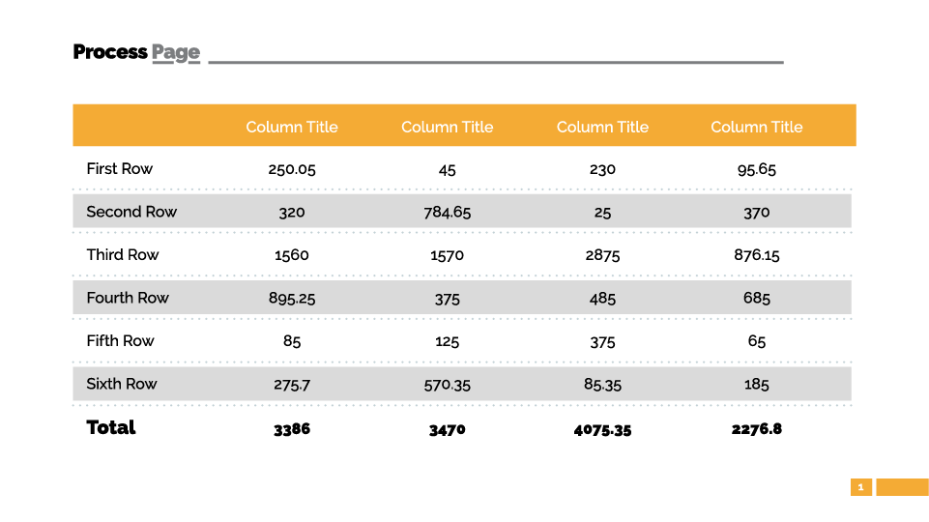
HTML Tables

Slide 12
HTML Tables
Elements of a Table
<th>
<table>
<thead>
Column Header 1 | Column Header 2 | Column Header 3
Row 1 – Column 1 | Row 1 – Column 2 | Row 1 – Column 3
Row 2 – Column 1 | Row 2 – Column 2 | Row 2 – Column 3
Row 3 – Column 1 | Row 3 – Column 2 | Row 3 – Column 3
<tr>
<tbody>
<tr>: Row <th>: Cells inside <thead> <td>: Cells inside a row
<td>

Slide 13
HTML Tables
HTML <table>
<body> <table align=”right”> <thead> <tr> <th>Fruit</th> <th>Quantity</th> </tr> </thead> <tbody> <tr> <td>Apples</td> <td>10</td> </tr> <tr> <td>Oranges</td> <td>15</td> </tr> </tbody> </table> </body>

Slide 14
HTML Tables
HTML <table> - rowspan
<table> <thead> <tr> <th>Fruit</th> <th>Quantity</th> <th>Is healthy?</th> </tr> </thead> <tbody> <tr> <td>Apples</td> <td>10</td> <td rowspan="2">Healthy</td> </tr> <tr> <td>Oranges</td> <td>15</td> </tr> </tbody> </table>

Slide 15
HTML Tables
HTML <table> - colspan
<table> <thead> <tr> <th>Fruit</th> <th>Quantity</th> </tr> </thead> <tbody> <tr> <td>Apples</td> <td>10</td> </tr> <tr> <td>Oranges</td> <td>15</td> </tr> <tr> <td colspan="2">25</td> </tr> </tbody> </table>

Slide 16
Poll 4(15 Sec)
Which of the following tags is used to define a table?
<tabular>
<table>
<th>
<tr>
Practice in teams of 4 students
Industry expert mentoring to learn better
Get personalised feedback for improvements
16

Slide 17
Poll 4(Answer)
Which of the following tags is used to define a table?
<tabular>
<table>
<th>
<tr>
Practice in teams of 4 students
Industry expert mentoring to learn better
Get personalised feedback for improvements
17

Slide 18
Poll 5(15 Sec)
Which of the following tags is used to add a row to a table?
<tr></tr>
<td></td>
<th></th>
<table></table>
Practice in teams of 4 students
Industry expert mentoring to learn better
Get personalised feedback for improvements
18

Slide 19
Poll 5(Answer)
Which of the following tags is used to add a row to a table?
<tr></tr>
<td></td>
<th></th>
<table></table>
Practice in teams of 4 students
Industry expert mentoring to learn better
Get personalised feedback for improvements
19

Slide 20
Poll 6(15 Sec)
How do you align a table to the right?
<table align=”right”>
<table right>
<align=”right” table>
None of the above
Practice in teams of 4 students
Industry expert mentoring to learn better
Get personalised feedback for improvements
20

Slide 21
Poll 6(Answer)
How do you align a table to the right?
<table align=”right”>
<table right>
<align=”right” table>
None of the above
Practice in teams of 4 students
Industry expert mentoring to learn better
Get personalised feedback for improvements
21

Slide 22

Project Work
(We shall create the structure of all the HTML pages required for our project.)
You can refer to the solution here.

Slide 23
Doubt Clearance (5 min)

Slide 24
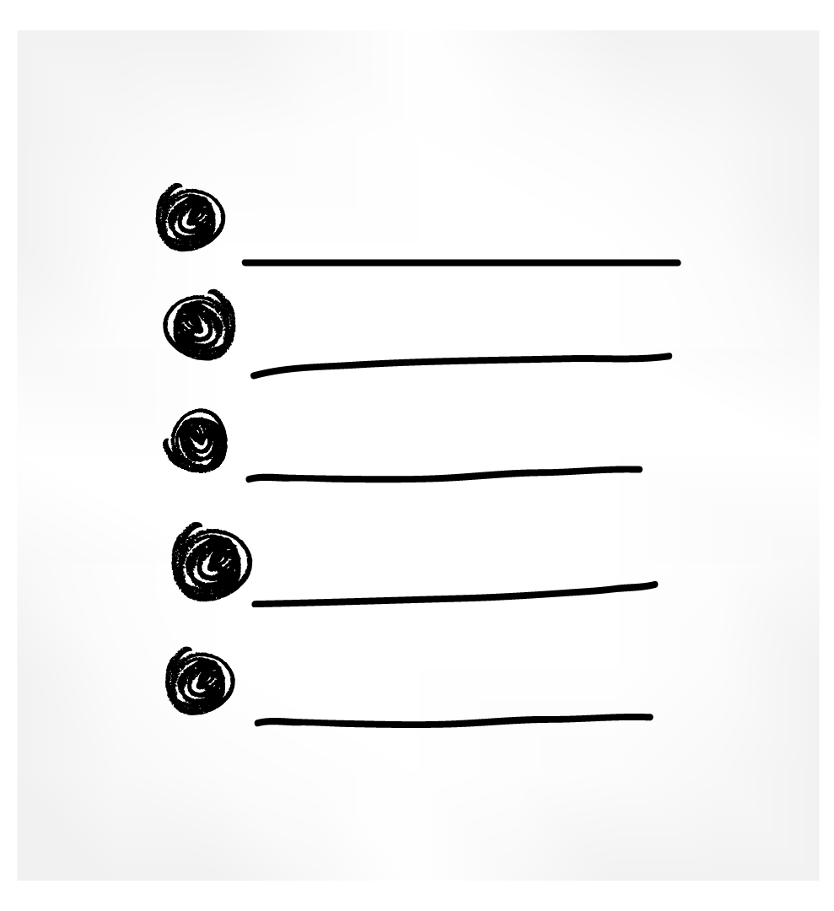

HTML Lists

Slide 25
HTML Lists
Types of Lists
<body> <h4>Ordered Lists</h4> <ol type="1"> <li>Flour (95 grams)</li> <li>Sugar (2 tbsp)</li> </ol> <ol type="I"> <li>Flour (95 grams)</li> <li>Sugar (2 tbsp)</li> </ol> <ol type="i"> <li>Flour (95 grams)</li> <li>Sugar (2 tbsp)</li> </ol> <ol type="A"> <li>Flour (95 grams)</li> <li>Sugar (2 tbsp)</li> </ol> <ol type="a"> <li>Flour (95 grams)</li> <li>Sugar (2 tbsp)</li> </ol> </body>
Ordered lists: These are lists with numbers and alphabets.

Slide 26
HTML Lists
Types of Lists
Unordered lists: These are lists with bullets and shapes.
<body> <h4>Unordered Lists</h4> <ul style="list-style-type:disc;"> <li>Flour (95 grams)</li> <li>Sugar (65 grams)</li> </ul> <ul style="list-style-type:square;"> <li>Flour (95 grams)</li> <li>Sugar (65 grams)</li> </ul> <ul style="list-style-type:circle;"> <li>Flour (95 grams)</li> <li>Sugar (65 grams)</li> </ul> <ul style="list-style-type:none;"> <li>Flour (95 grams)</li> <li>Sugar (65 grams)</li> </ul> </body>

Slide 27
HTML Lists
Types of Lists
Description lists: These are lists that define a list.
<body> <h4>Description Lists</h4> <dl> <dt>Flour</dt> <dd>- 95 grams</dd> <dt>Sugar</dt> <dd>- 2 tbsp</dd> </dl> </body>

Slide 28
HTML Lists
Types of Lists
Nested lists: These are lists that contain another list.
<body> <h4>Nested Lists</h4> <ul> <li>Powders</li> <ol> <li>Cocoa Powder (1/4 cup)</li> <li>Baking Powder (2 tbsp)</li> </ol> </ul> </body>

Slide 29
Project Work
(We shall add HTML Lists to our project wherever needed.)
You can refer to the solution here.

Slide 30
Poll 7(10 Sec)
Which of the following tags is used to create a bulleted list?
<ol>
<ul>
<li>
None of the above
Practice in teams of 4 students
Industry expert mentoring to learn better
Get personalised feedback for improvements
30

Slide 31
Poll 7(Answer)
Which of the following tags is used to create a bulleted list?
<ol>
<ul>
<li>
None of the above
Practice in teams of 4 students
Industry expert mentoring to learn better
Get personalised feedback for improvements
31

Slide 32
Poll 8(10 Sec)
Which of the following lists can be created using <ol>?
Numbered list
Bulleted list
Ordered list
Description list
Practice in teams of 4 students
Industry expert mentoring to learn better
Get personalised feedback for improvements
32

Slide 33
Poll 8(Answer)
Which of the following lists can be created using <ol>?
Numbered list
Bulleted list
Ordered list
Description list
Practice in teams of 4 students
Industry expert mentoring to learn better
Get personalised feedback for improvements
33

Slide 34
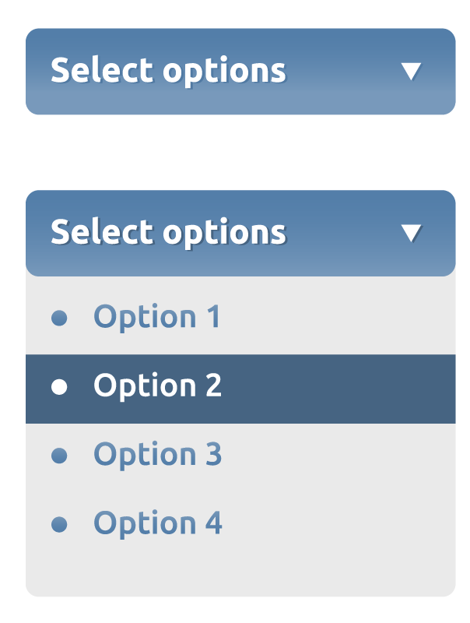
HTML Select

Slide 35
HTML Select
<html> <head> <title> HTML Select </title> </head> <body> <select name="choose"> <option value="choice1">Choice 1</option> <option value="choice2">Choice 2</option> <option value="choice3">Choice 3</option> </select> </body> </html>

Slide 36
Project Work
(We shall add HTML Select to our project wherever needed.)
You can refer to the solution here.

Slide 37
Poll 9(10 Sec)
Which of the following tags is used to create a dropdown list?
<list>
<dropdown>
<select>
None of the above
Practice in teams of 4 students
Industry expert mentoring to learn better
Get personalised feedback for improvements
37

Slide 38
Poll 9(Answer)
Which of the following tags is used to create a dropdown list?
<list>
<dropdown>
<select>
None of the above
Practice in teams of 4 students
Industry expert mentoring to learn better
Get personalised feedback for improvements
38

Slide 39
HTML iFrame

Slide 40
HTML iFrame
<html> <head> <title>iFrame</title> </head> <body> <!-- iframe embeds another webpage in the current webpage --> <iframe src="https://www.google.com/" title="Google"></iframe> </body> </html>
You can read more about it here.

Slide 41
Project Work
(We shall add all the images and anchors to our pages.)
You can refer to the solution here.

Slide 42
Poll 10(10 Sec)
Which of the following tags is used to display a web page within another web page?
<div>
<span>
<iframe>
None of the above
Practice in teams of 4 students
Industry expert mentoring to learn better
Get personalised feedback for improvements
43

Slide 43
Poll 10(Answer)
Which of the following tags is used to display a web page within another web page?
<div>
<span>
<iframe>
None of the above
Practice in teams of 4 students
Industry expert mentoring to learn better
Get personalised feedback for improvements
44

Slide 44

Hands-On Exercise (3 min)
Write a program that consists of the following four <div> tags:
The first div with text ‘container1’ consists of an ordered list with items - HTML, CSS, JavaScript.
The second div with text ‘container2’ consists of a dropdown, which has three options: upgrad, Google and Instagram.
The third div with text ‘container3’ consists of a paragraph with text ‘External webpage’.
The fourth div with text ‘container4’ consists of an embedded page, https://www.upgrad.com/, of height 450 and width 700.
Your page should look like the one shown in this image.
You can find the stub code here.
You can find the solution here.

Slide 45
Key Takeaways
You can create HTML tables using <table>, <tr>, <td> and <th> tags.
Lists can be ordered (with numbers or alphabets), unordered (with bullets or shapes) or can be description lists using <ol>, <ul> and <dl> tags respectively.
We can also create nested lists.
You can create dropdown lists using <select> and <option> tags.
You can display a web page in another web page using <iframe> tag.

Slide 46
Doubt Clearance (5 min)

Slide 47
Tasks to Complete After Today’s Session
MCQs
Coding Questions
Project: Checkpoint 2

Slide 48
In the next class, you will learn...
How to create forms in HTML?
How to add the ‘Login’ and ‘Contact Us’ features to your website?

Slide 49
#RahoAmbitious
Thank You!

